Slide 1

Problem Statement and Team Details
Problem Statement:Managing finances is one of the biggest challenges for startup founders, student fest organizers, and small businesses. People constantly struggle with questions like “If I hire more staff, how long will my budget last?” or “What happens if I increase prices or marketing spend?” Existing tools like Excel are static and fail to show clear “what-if” outcomes. There is a strong need for a simple, interactive solution that provides real-time financial forecasts and actionable insights.
Team Name: Hakuna Matata
Team Leader Name: Narisetti Dhanush
Institute Name: KLH Bachupally
Team Leader Email ID: 2420040059@klh.edu.in

Slide 2
Problem and Solution
Problem Statement
For startups, student fest organizers, and small businesses, managing money feels like walking in the dark. Questions like “Can I survive six months if I hire more staff?”, “What if I take a loan?”, or “How will profits change if I increase prices?” often remain unanswered. Tools like Excel are outdated and fail to provide clear, real-time, and actionable financial insights, leaving decision-makers confused and at risk.
Our Solution
We developed a web-based CFO Helper that works like a virtual financial advisor. Instead of complex graphs, it provides direct, easy-to-understand text-based answers and reports to user queries. Whether it’s about budget survival, profit margins, or loan guidance, the system instantly simulates scenarios and provides actionable financial insights. It also allows users to generate shareable reports, while Flexprice handles billing per simulation/report and Pathway ensures data stays up to date.

Slide 3
Methodology & Implementation
Data Collection
Gathered financial datasets from web sources, Google, and trusted banking sites.
Used this data to model expenses, revenues, loan structures, and market trends.
User Interaction
Users can either adjust sliders (hires, marketing spend, pricing) or ask direct financial questions.
The interface is designed to be simple, intuitive, and mobile-friendly.
Computation Engine
Processes user inputs with collected financial benchmarks.
Calculates runway, profit/loss, loan affordability, and budgeting scenarios.
Visualization & Reports
Forecasts are displayed as clear text insights and interactive charts.
Users can export/share reports instantly for decision-making.
Integrations
Flexprice → Bills per simulation/report & tracks usage count.
Pathway → Streams fresh data (mock/live financial updates) to keep forecasts current.

Slide 4
Technology Used
Built a simple and intuitive web interface for user queries and input sliders.
Displays financial insights and text-based reports clearly.
Backend (Financial Logic Engine)
Handles calculations for expenses, revenue, burn rate, runway, and loan scenarios.
Powered by Python / Flask / FastAPI for fast processing.
Data Sources
Frontend (Web App)
Collected from Google, banking websites, and open financial datasets.
Used as benchmarks for expenses, loan structures, and revenue patterns.
Integrations
Flexprice → Bills per simulation/report and tracks usage count.
Pathway → Pulls mock/real-time financial data to refresh outcomes automatically.
Deployment
Hosted as a web-based solution accessible via browser.

Slide 5
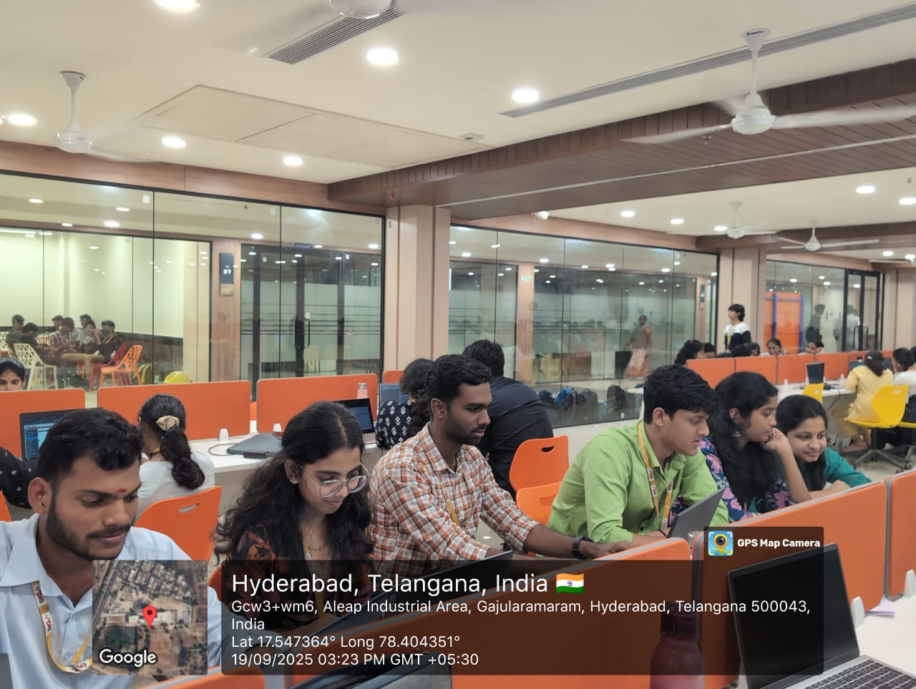
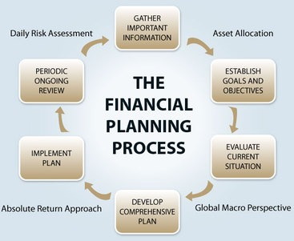
Flowchart & Supporting Images

Slide 6
Feasibility and Market Use
Feasibility
The solution is lightweight, web-based, and easy to deploy, requiring only a browser.
Data can be updated from public financial sources, banks, or integrated APIs, making it adaptable.
Scales easily with cloud hosting and can be extended to mobile platforms.
Flexprice ensures a sustainable pay-per-use billing model, making operations cost-effective.
Market Use
Startups → For budgeting, hiring, and runway planning.
Student & Event Organizers → To manage sponsorships, prizes, and expenses effectively.
Small Businesses → To test price changes, loans, and marketing investments.
Financial Institutions / EdTech → Can embed it as a financial literacy tool.
Large potential market since 80% of SMEs and organizers rely on Excel/manual methods — this tool is a smarter, simpler alternative.

Slide 7
Conclusion
The CFO Helper Agent is designed to solve one of the most common yet difficult challenges faced by startups, student organizers, and small businesses — managing money and making the right financial decisions. Traditional methods like Excel are limited and fail to answer “what-if” scenarios that matter most for survival and growth.
Our web-based solution acts as a virtual financial advisor that provides clear, text-based insights for budgeting, hiring, spending, pricing, and even loan planning. Users can quickly simulate financial scenarios and receive actionable reports that help them make informed decisions with confidence.
By integrating Flexprice, we ensure a sustainable pay-per-use billing model, and with Pathway, we provide real-time financial updates to keep insights accurate and relevant. The system is lightweight, scalable, and deployable on the web, making it highly feasible for immediate use.
In the long run, this solution has the potential to become a go-to platform for small businesses, startups, and event organizers who lack access to professional financial advisors. It not only simplifies complex financial planning but also builds trust by providing transparent, easy-to-understand answers.
Thus, the CFO Helper Agent is not just a hackathon project — it is a practical, scalable, and market-ready innovation that can empower thousands of organizations to make smarter financial choices and thrive.

